Slide 1


Department of Computer Science and Engineering
A Blockchain-Based Credible and Secure Education data Management using PBFT Algorithm
TEAM MEMBERS
V.Valarmathy(211419104295)
S.Suruthi(211419104277)
S.Revathi(211419104221)
Guided by:
Dr.A.Hemlathadhevi ME PhD
Professor
Coordinator Name:
Dr K Valarmathi ME PhD Professor

Slide 2
Introduction
Some academic centers allow a quick and simple online query to verify the authenticity of student’s academic information without even asking who requires that information.
This leads to academic frauds and information stealing from the students and misusing it.
Hence Blockchain come in handy to store students information encrypted in the database.
Blockchain acts as a ledger system where data stored in a transparent and immutable format.
The PBFT algorithm is the key method to make the blockchain consistent.

Slide 3
Objective of the Project
The main objective of the project the keyword dictionary sent by the data owner
The smart contract can perform the search algorithm according to the user’s query keywords, and return the abstract and encrypted keywords of the corresponding data file found.
After the query is completed, the transaction between the data owner and the user, that is, the query record can be published in the block chain.

Slide 4
Literature Survey
SNO: | YEAR | TITLE OF THE PAPER | AUTHOR | DESCRIPTION
1. | 2023 | Improved PBFT Consensus Algorithm Based on Node Role Division | Ren, X., Tong, X. and Zhang, W. | This paper discusses the core of the PBFT consensus algorithm that is composed of consistency protocol, checkpointing protocol, and view change protocol.
2. | 2023 | Improved PBFT Algorithm Based on Comprehensive Evaluation Model | Jiang, Wangxi, Xiaoxiong Wu, Mingyang Song, Jiwei Qin, and Zhenhong Jia | This paper discusses the difference between blockchain systems and traditional distributed systems is that the environment is complex, and Byzantine nodes will be introduced even in strict consortium blockchains, so research on the

Slide 5
Literature Survey
SNO: | YEAR | TITLE OF THE PAPER | AUTHOR | DESCRIPTION
3. | 2022 | Blockchain-based model to track and verify official certificates | Pooja Mara, Ravi kanth Motupalli | In this paper ,the Authors have developed a web-based application that is using Blockchain technology to store academic certificates to avoid certificate counterfeit as lots of fake certificates are being stolen and used to get jobs
4. | 2021 | Revolutionizing Verification and Management of Educational Certificates with Self-Sovereign Student Identities using Blockchain | Harshita Bhosale, Rutuja Kanki, Gayatri Jaiswal | In this paper, a framework which is a decentralized system is discussed.It performs a mechanism for the system to enable us to validate and track the operations performed by these institutions.

Slide 6
Literature Survey
SNO: | YEAR | TITLE OF THE PAPER | AUTHOR | DESCRIPTION
5. | 2021 | Development and Evaluation of Blockchain based Secure Application for Verification and Validation of Academic Certificates | Elva Leka, and Besnik Selimi | This paper have created a basic interface where the data is formatted and encrypted. Later a transaction is built, and after signing it with the private key, it is sent to the network.
6. | 2021 | Counterfeit Detection of Documents using Blockchain | Rajesha, Rohini Krishna Mohite, Sahana S, Shilpashree B and, Rakesh K R | This paper discusses the Blockchain technology characteristics and its structure

Slide 7
Literature Survey
SNO: | YEAR | TITLE OF THE PAPER | AUTHOR | DESCRIPTION
7. | 2020 | Verifiable decentralized access control for distributed databases | Xiaowen Feng, Pengcheng Deng,Yanzi Yi, Qi Yu, Decun Luo, Hua Deng, Yujue Wang | This paper proposes a verifiable decentralized access control (VDAC) scheme for distributed database. In this scheme, the users’ access records are encrypted and stored on the blockchain, so that only the database manager is able to access and audit them

Slide 8
Existing System
Centralized storage and management mode is usually adopted, which makes systems that use this mode vulnerable to various attacks.
The records of different educational stages are stored in separate storage servers of education institutions and these storage servers are usually designed to allow access only by internal staff
In this system , a server failure could easily cause a data loss or leakage

Slide 9
Existing Algorithm
Database Clustering is the process of combining more than one servers or instances connecting to a single database.
Sometimes one server may not be adequate to manage the amount of data or the number of requests, that is when a Data Cluster is needed.
SQL is the language used to manage the database information. Clustering takes different forms, depending on how the data is stored and allocated resources.

Slide 10
Clustering Algorithm(Existing Algorithm)
studLoginId=XYZ
if(StudEnteredID== studLoginId)
Login to DB;
View Academic Data;
else
Login access not provided;
There is no Secret key to protect the academic data of students

Slide 11
Proposed System
The blockchain is responsible for ensuring the security and auditability of the data, the smart contract is used to define the permissions of the records and to regulate the behaviours of the member nodes
We remark that public blockchain is not suited in this case, because educational records are related to personal privacy and contain sensitive information, such as family address, age, contact details, etc.

Slide 12
Proposed System
Moreover, even if the institutions put encrypted data on the public blockchain, it still will expose their operation situations and statistical data.
We firstly use data masking for the part of the student’s private data and then encrypt it and store it on the server.
The user must have the authorization of the data owner to query the data, and the verification of the user’s authority is realized using a smart contract. Students can take their documents using key from the server.

Slide 13
Proposed Algorithm
studLoginId=XYZ
if(StudEnteredID== studLoginId)
Login to DB;
Gives request to view data;
if(request accepted && key sent to student)
Enters key;
View Academic Data;
else if(request not accepted && key not sent)
No access to data
else
Login access not provided;
There is Secret key to protect the academic data of students in our proposed system.

Slide 14
Software / Hardware used
HARDWARE SYSTEM CONFIGURATION:
Processor - Intel i3,i5,i7, AMD Processor
RAM - above 4 Gb
Hard Disk - above 500 GB
SOFTWARE SYSTEM CONFIGURATION:
Operating System - Windows 10
Front End - GUI
Language - Python 3.10

Slide 15
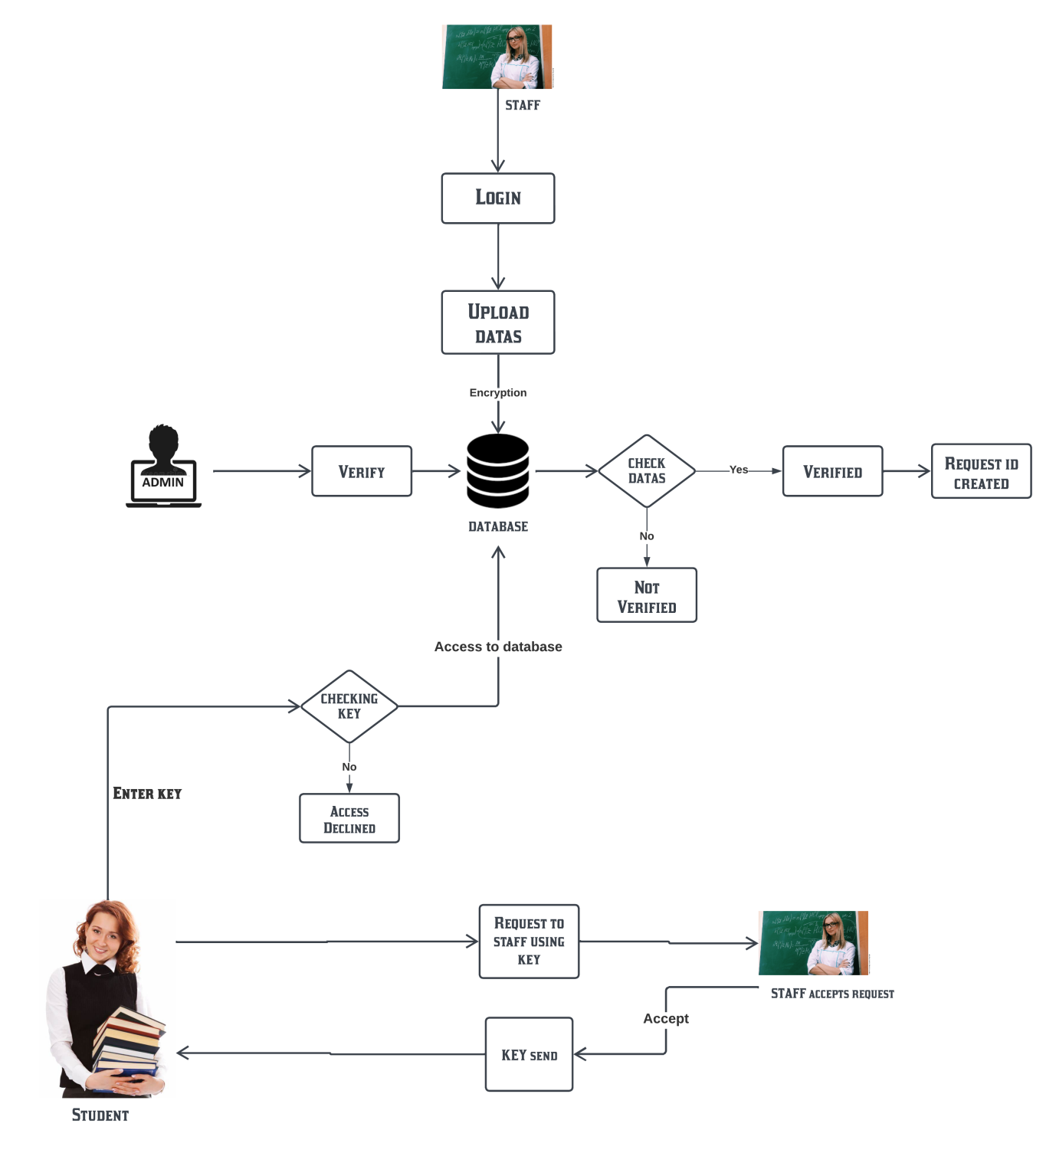
Architecture Diagram

Slide 16
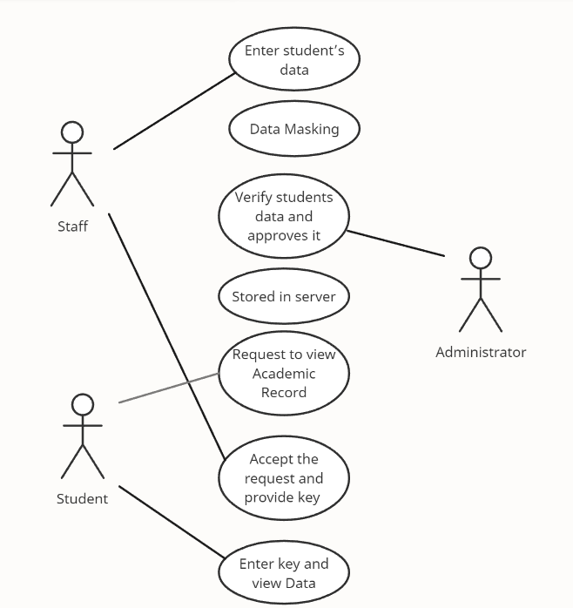
System Design – Use Case Diagram

Slide 17
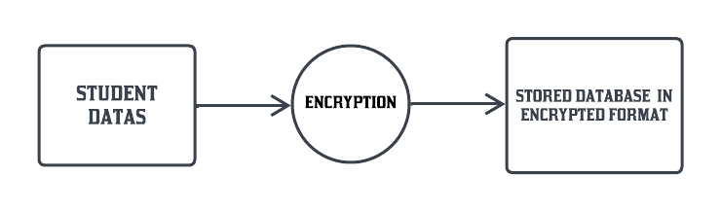
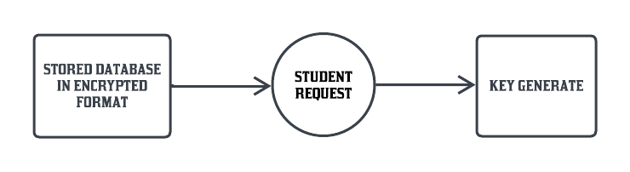
System Design – DFD Diagram
DFD DIAGRAM:
DFD LEVEL 0:
DFD LEVEL 1:

Slide 18
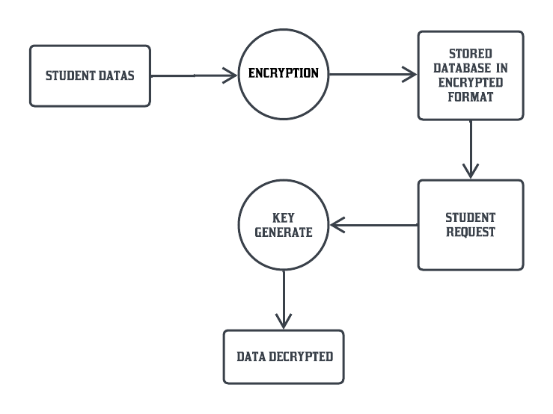
System Design – DFD Diagram
DFD DIAGRAM:
OVERALL DFD :

Slide 19
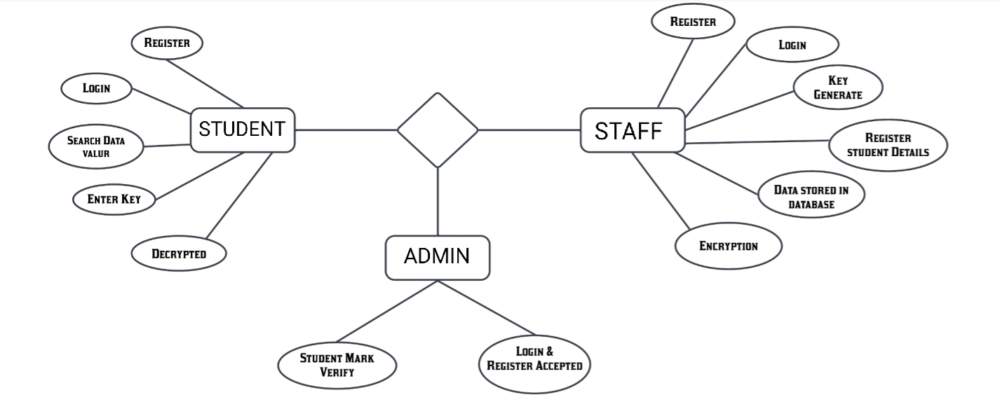
System Design – ER Diagram
DB

Slide 20
Module Description
DATA REQUEST:
The Students Data that is entered and encrypted in the Blockchain Database can only be accessed through Secret Key.
Once the student sends Data access request, it then comes under staff approval.
When the staff gives approval, the respective secret key for that students data is sent to the student.

Slide 21
Module Description
ENCRYPTED DATA STORING:
The encrypted data is stored in the storage server and their hash is put on the blockchain and keyword also generated for the each student for the security. The amount of data on student education records is huge.
For the transmission of big data used Encryption algorithm. The original records and files are encrypted and stored in the storage server. The blockchain database is chosen as the storage server to efficiently store and retrieve data and support encrypted storage of files.

Slide 22
Module Description
DATA ACCESS BY ENTERING KEY:
After storing the data into the databases , that is then available in the server but the student have to enter the keyword for the accessing their data’s.
So, after entering the key, the student get access to the storage server and able take his documents easily.
The blockchain is applied in several domains and acts as a trusted data storage technology. This technology is often used for information secure storage and information traceability, because of its decentralized and anti-tampering characteristics.

Slide 23
AES Algorithm
The AES algorithm is a symmetrical block cipher algorithm that takes plain text in blocks of 256 bits and converts them to ciphertext using keys of 128, 192, and 256 bits
SHA-256 in cryptographic hash function.
Uses 256 bit key to encrypt data into unrecognizable text.
Plain text(32 bits words)-Block size(256 bits)
No of rounds-10 –cipher text(256 bits)

Slide 24
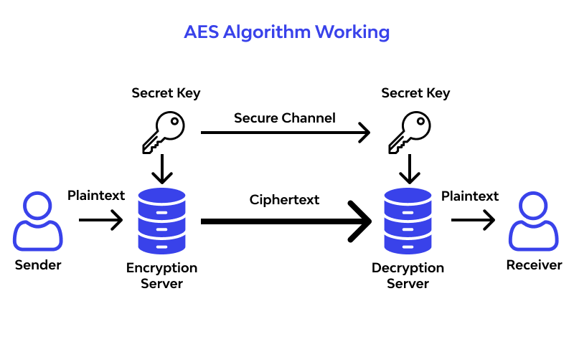
AES Algorithm

Slide 25
PBFT Algorithm
PBFT consensus rounds are broken into 4 phases(refer with the image in next slide):
The client sends a request to the primary(leader) node.
The primary(leader) node broadcasts the request to the all the secondary(backup) nodes.
The nodes(primary and secondaries) perform the service requested and then send back a reply to the client.
The request is served successfully when the client receives ‘m+1’ replies from different nodes in the network with the same result, where m is the maximum number of faulty nodes allowed.

Slide 26
PBFT Algorithm-Communication Complexity
Assuming the number of nodes of the PBFT algorithm is n,
The consensus process of PBFT algorithm can be divided into five phases: The request phase(1), pre-prepare phase(n−1), prepare phase (n −1)(n −1), commit phase(n(n −1)), and reply phase(n).
The communication complexity can be calculated to be 1 + (n −1) + (n −1)(n −1)+n(n −1)+n
The Communication complexity of the PBFT algorithm
C1= 2n ² − n+1

Slide 27
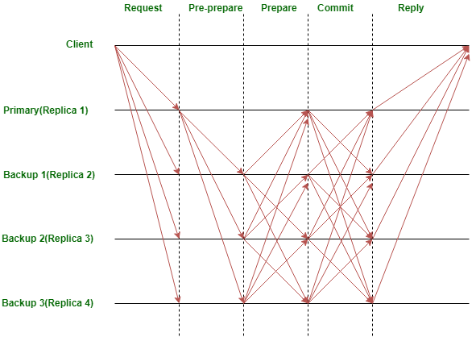
PBFT Algorithm

Slide 28
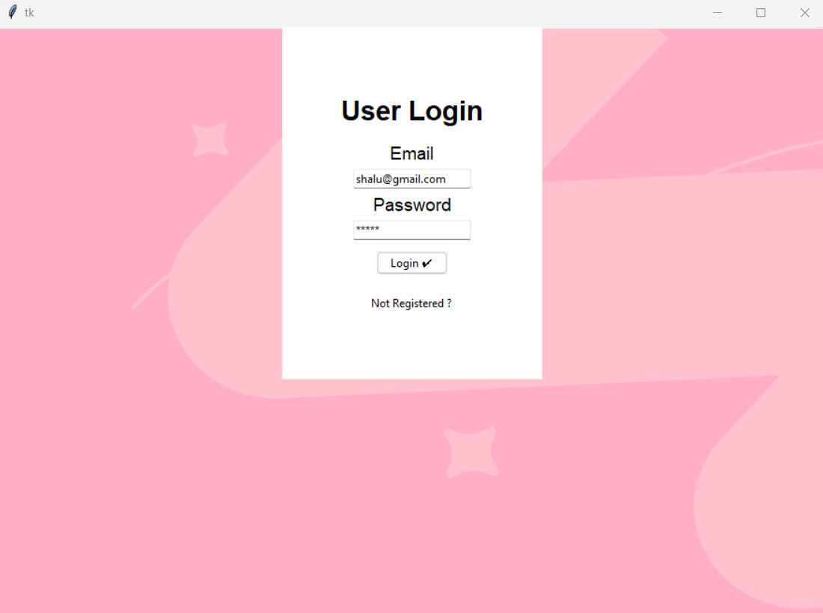
Screen Shots
User login

Slide 29
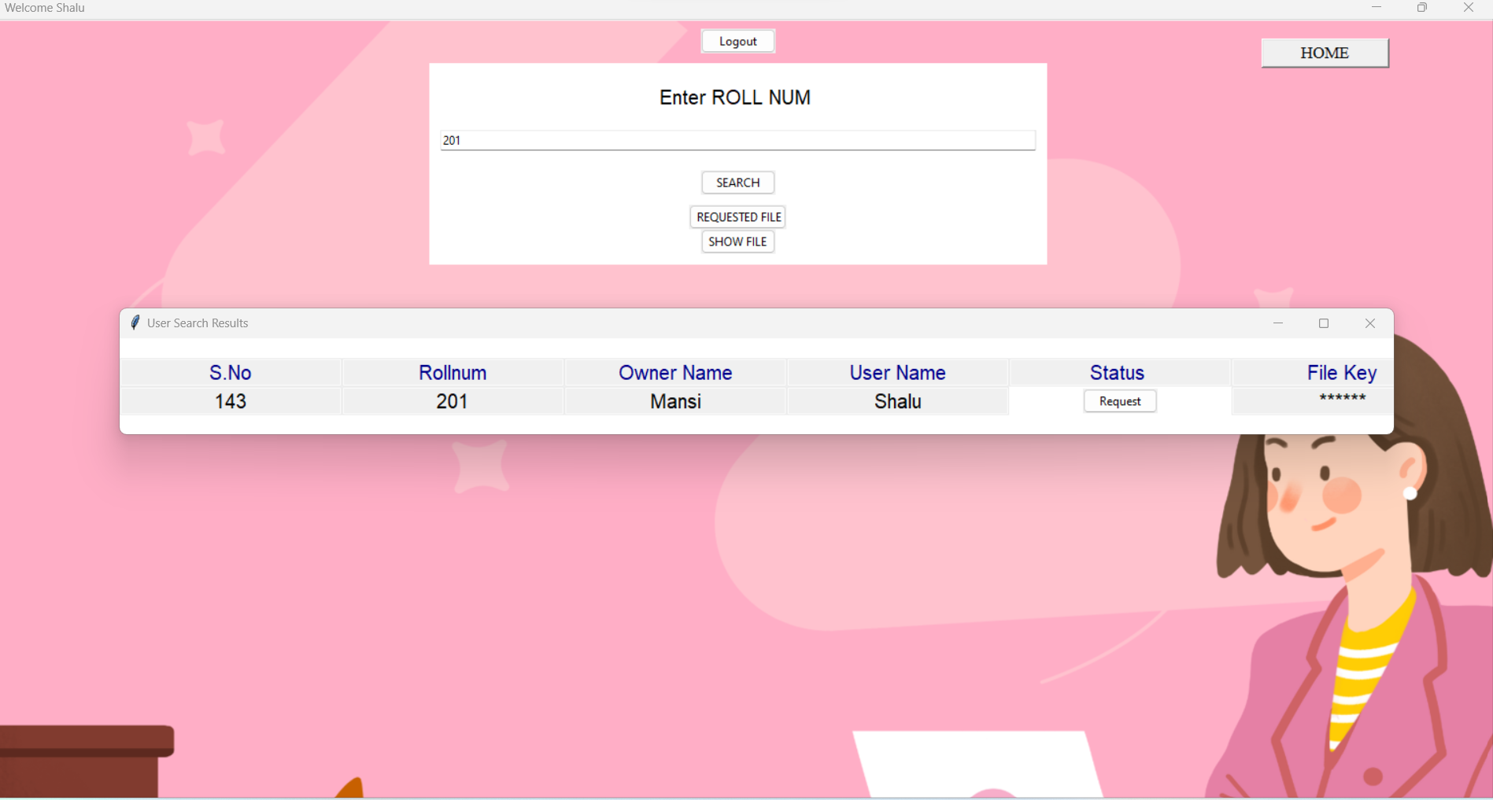
Screen Shots
Request academic data:

Slide 30
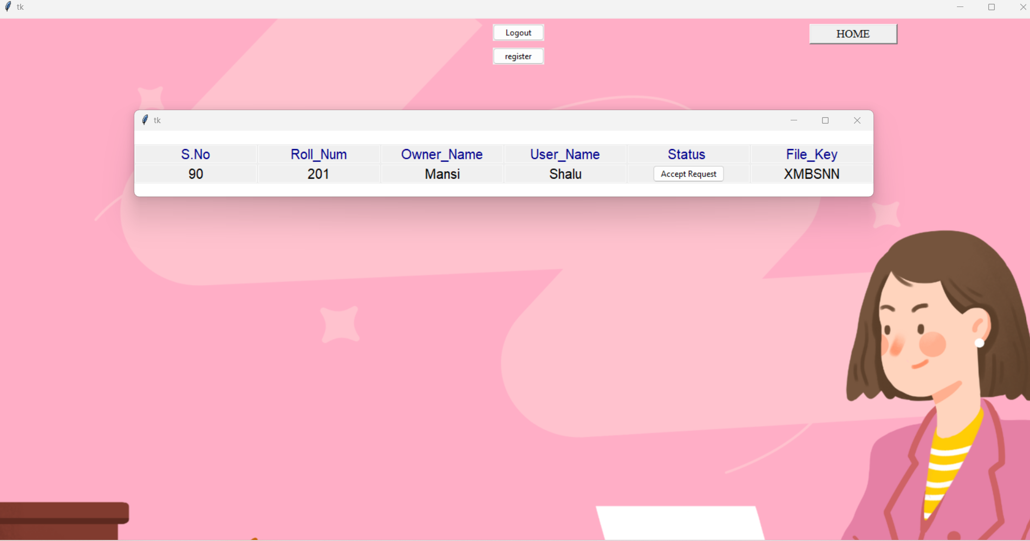
Screen Shots
Staff provides access & key sent to user

Slide 31
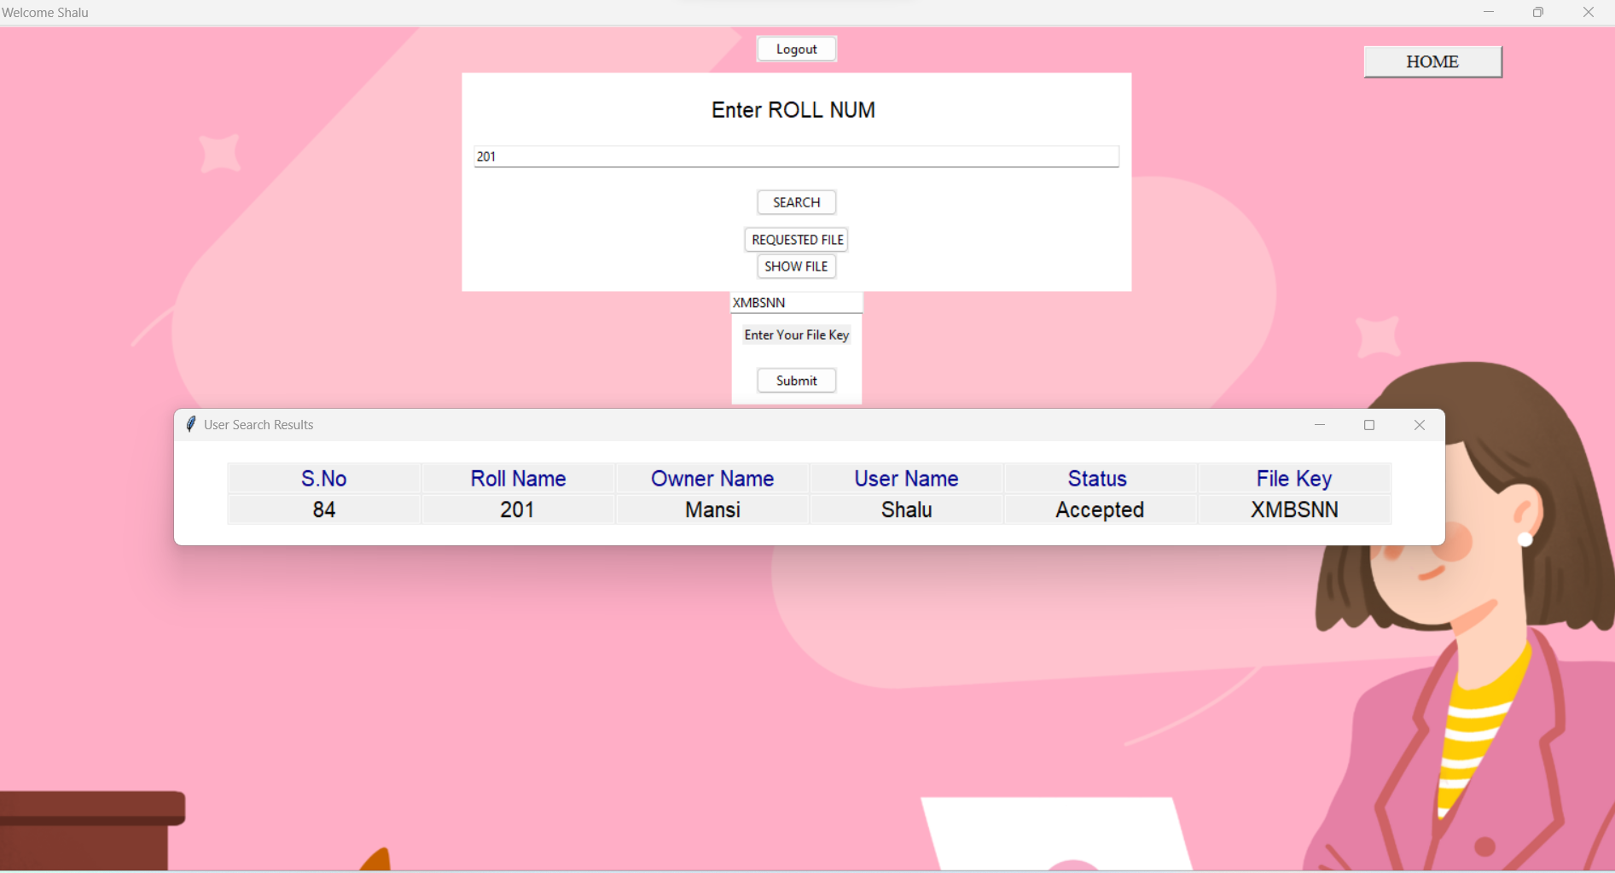
Screen Shots
Enters Staff approved key:

Slide 32
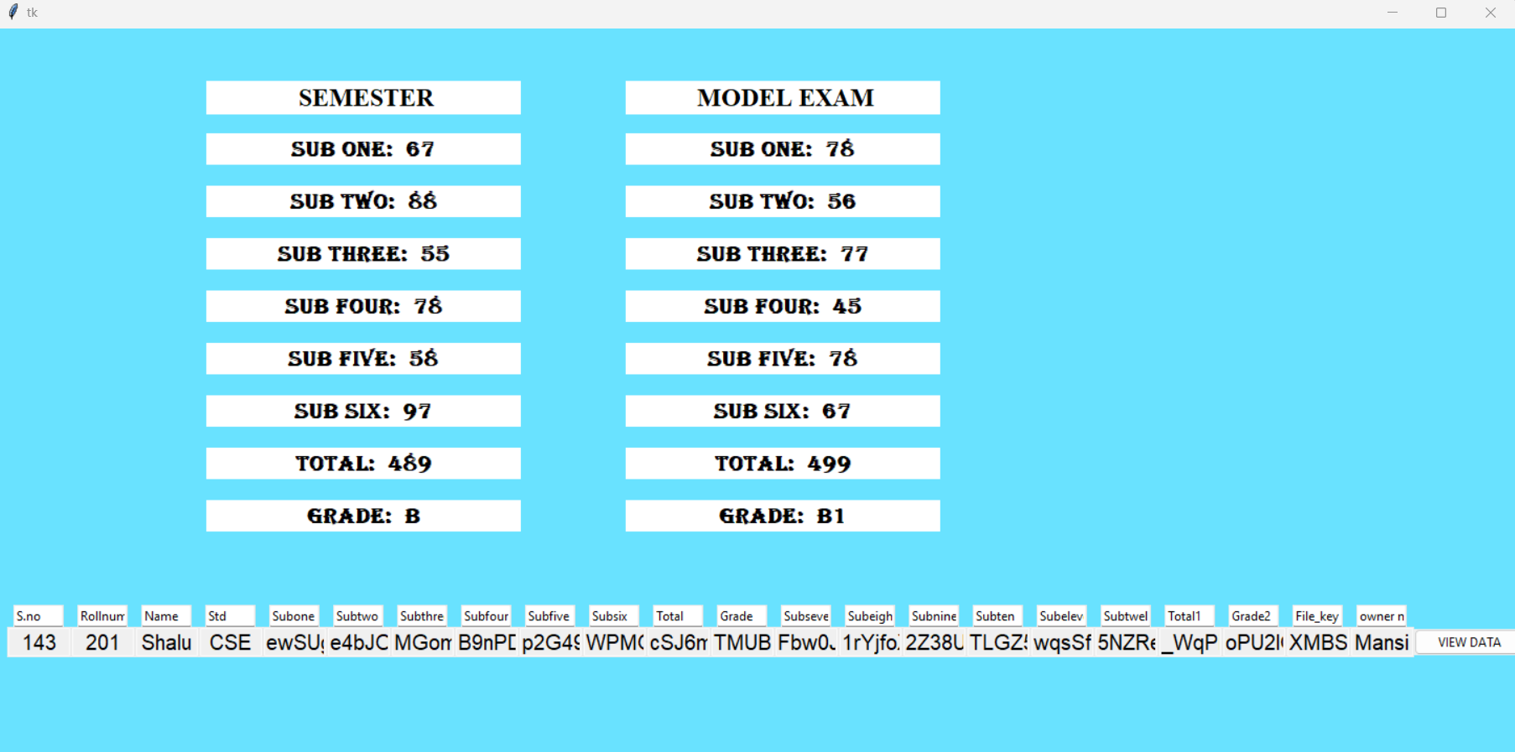
Screen Shots
Access to Academic data:

Slide 33
Conclusion / Future Enhancement
Aiming at the need for protection and sharing of educational records, a secure storage and sharing scheme based on the blockchain, referred to as EduRSS is proposed in this paper.
In our proposal, the integrity and security of the data can be ensured by the consortium chain between institutions. A distributed institution authentication mechanism is proposed to ensure the security of blockchain nodes.
Secure Storage is achieved by combining Blockchain and Storage Server.
Finally, an anti-tampering inspection mechanism is employed to protect records in the storage server.

Slide 34
Reference Paper/ URL
[1] 2023-Ren, X., Tong, X. and Zhang, W. "Improved PBFT Consensus Algorithm Based on Node Role Division. Journal of Computer and Communications", 11, 20-38. (2023) Doi: 10.4236/jcc..112003.
[2] 2023-Jiang, Wangxi, Xiaoxiong Wu, Mingyang Song, Jiwei Qin, and Zhenhong Jia. "Improved PBFT Algorithm Based on Comprehensive Evaluation Model." Applied Sciences 13, no. 2 : 1117.
[3] 2022- Pooja Mara, Ravi kanth Motupalli, “Blockchain-based model to track and verify official certificates,” pp. Volume No.6 January

Slide 35
Reference Paper/ URL
[4] 2021-Elva Leka, and Besnik Selimi, “Development and Evaluation of Blockchain based Secure Application for Verification and Validation of Academic Certificates,” pp. Vol. 5, No. 2
[5] 2021-Rajesha, Rohini Krishna Mohite, Sahana S, Shilpashree B and, Rakesh K R, “Counterfeit Detection of Documents using Blockchain,” IJERT paper, Vol. 10 Issue 07, July
[6] 2021-Harshita Bhosale, Rutuja Kanki, Gayatri Jaiswal, “Revolutionizing Verification and Management of Educational Certificates with Self-Sovereign Student Identities using Blockchain,” irjet paper, pp. Volume No.6 January

